Slide 1
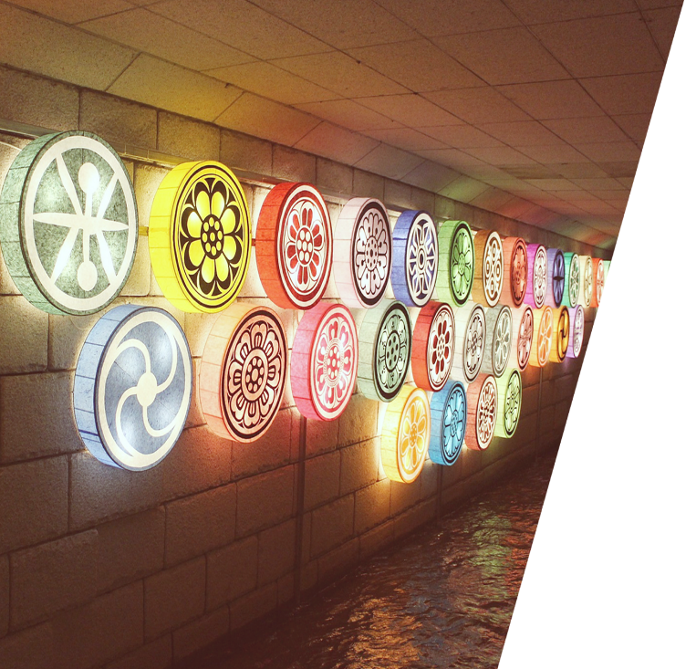
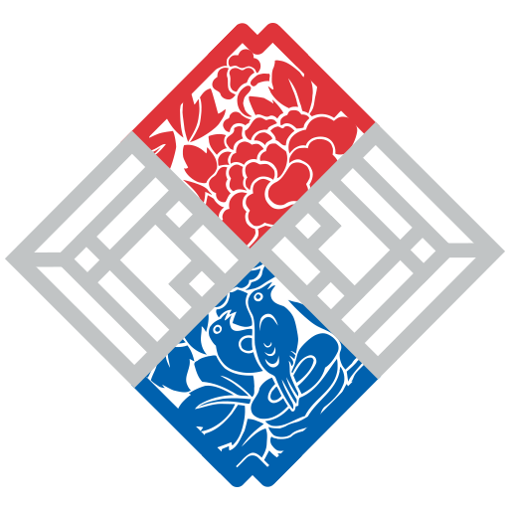
Part 4
Appendix
&
References

Slide 2
The names of the letters
Consonant letters
ㄱ | ㄴ | ㄷ | ㄹ | ㅁ | ㅂ | ㅅ
기윽 (기역) | 니은 | 디읃 (디귿) | 리을 | 미음 | 비읍 | 시읏 (시옷)
ㅇ | ㅈ | ㅊ | ㅋ | ㅌ | ㅍ | ㅎ
이응 | 지읒 | 치읓 | 키읔 | 티읕 | 피읖 | 히읗
Modern (New)Version: C + 이 C + 은
Notice that the name of each consonant letter begins and ends with the sound in question.
ㅣ | 은

Slide 3
철자 표기법 (Romanization)
(in this class)
Consonant letters
ㄱ | ㄴ | ㄷ | ㄹ | ㅁ | ㅂ | ㅅ
g (k) | n | d (t) | l (r) | m | b/p | s
ㅇ | ㅈ | ㅊ | ㅋ | ㅌ | ㅍ | ㅎ
ng | j | ch | k | t | p | h
ㄲ | ㄸ | ㅃ | ㅆ | ㅉ
gg (kk) | dd (tt) | pp | ss | jj
Notes:
http://www.korean.go.kr/front_eng/roman/roman_01.do

Slide 4
철자 표기법 (Romanization)
(in this class)
Vowel and diphthong letters
ㅏ | ㅐ | ㅑ | ㅒ | ㅓ | ㅔ | ㅕ
a | ae | ya | yae | eo | e | yeo
ㅖ | ㅗ | ㅘ | ㅙ | ㅚ | ㅛ | ㅜ
ye | o | wa | wae | oe | yo | u (oo)
ㅝ | ㅞ | ㅟ | ㅠ | ㅡ | ㅢ | ㅣ
wo | we | w | yu | eu | ui | i

Slide 5
발음 표기법 (Sound transcription)
Consonant letters
ㄱ | ㄴ | ㄷ | ㄹ | ㅁ | ㅂ | ㅅ
g/k | n | d/t | r/l | m | b/p | s
ㅇ | ㅈ | ㅊ | ㅋ | ㅌ | ㅍ | ㅎ
ŋ | ** (j) | ch | k^{h} | t^{h} | p^{h} | h
ㄲ | ㄸ | ㅃ | ㅆ | ㅉ
k’ | t’ | p’ | s’ | **

Slide 6
발음 표기법 (Sound transcription)
Vowel and diphthong letters
ㅏ | ㅐ | ㅑ | ㅒ | ㅓ | ㅔ | ㅕ
a | ae | ya | ** | ə | ae | yə
ㅖ | ㅗ | ㅘ | ㅙ | ㅚ | ㅛ | ㅜ
** | o | wa | we | we | yo | u
ㅝ | ㅞ | ㅟ | ㅠ | ㅡ | ㅢ | ㅣ
wə | we | wi | yu | ** | ** | i

Slide 7
References - images
Slide 2: King Sejong the Great (background) [image]. Retrieved from https://brunch.co.kr/@5345341/48
Slide 3: King Sejong the Great [image]. (2016). https://namu.wiki/w/세종대왕
Slide 4: The statue of King Sejong the Great [image]. (2009). Retrieved from http://news.naver.com/main/read.nhn?mode=LSD&mid=sec&sid1=101&oid=018&aid=0002096732
Slide 7: Hunmin jeongeum [image]. Retrieved from http://study.zum.com/book/14122
Slide 8: the Academy of Worthies [Photograph]. (2012). Retrieved from http://blog.daum.net/_blog/BlogTypeView.do?blogid=05bR6&articleno=15961743
the Academy of Worthies [image]. Retrieved from http://www.hangeulmuseum.org/sub/eng_new/hangeul/jiphyeon.jsp
Slide 10-11: Stroke order images courtesy of Korea Tourism Organization and Cultural Heritage Administration of Korea.

